Slide 1

MIS 665-Final Project
By: Ethan Blouin

Slide 2
The Data
Imdb.com movie dataset
Over 5000 rows of data
28 columns of attributes
3 different data types

Slide 3
Original Dataset Correlation
 | imdb_score
num_voted_users | 0.410965
num_critic_for_reviews | 0.305303
num_user_for_reviews | 0.292475
duration | 0.261662
movie_facebook_likes | 0.247049
gross | 0.198021
director_facebook_likes | 0.170802
cast_total_facebook_likes | 0.085787
actor_2_facebook_likes | 0.083808
actor_1_facebook_likes | 0.076099
aspect_ratio | 0.059445
actor_3_facebook_likes | 0.052633
budget | 0.030688
facenumber_in_poster | -0.062958
title_year | -0.209167

Slide 4
Data Manipulation
Null columns
Columns that were unimportant to the project were dropped
Any columns in the color column that were null, were filled in with color
The duration column’s null rows were replaced with the mean of the duration of the rest of the movies
Dummy variable were also used for the color column
All data was converted to int64

Slide 5
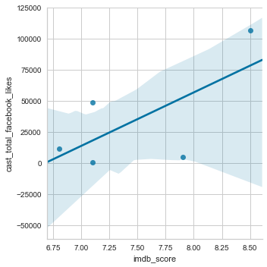
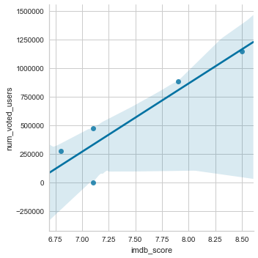
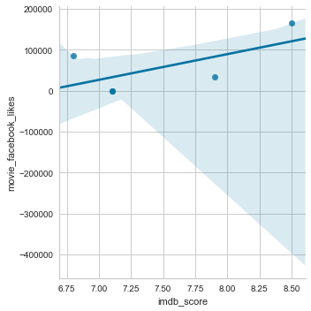
Key Attribute Relationships

Slide 6
Findings
Better to run regression model with all columns than just a few
Duration plays a big part in imdb score
Movies were broke up in different clusters based off of popularity
All movies in cluster 1 were in category 3, meaning all movies in cluster 1 are extremely popular
Cluster 0, while it had popular movies, consist of smaller less known movies

Slide 7
Summary
Producers should make sure the movies is at least 110 minutes long
Having an actors who aren’t necessarily famous, but very active and good with social media is a plus
Just because imdb score is high doesn’t guarantee a high gross figure
Most attributes had small coefficients, so getting multiple attributes correct is very important

